Slide 1
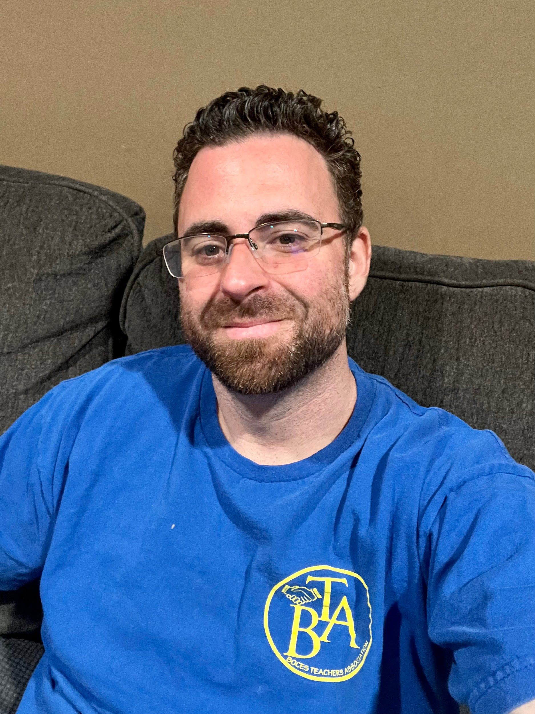
MIKE PICCOLO FOR BTA UNION GRIEVANCE CHAIRPERSON
Hi, my name is Mike Piccolo. I started as an aide 17 years ago and am now a TA. Eight years ago I joined the BTA Union as a Teacher/TA representative. Two years ago I was voted in by you, the members, to become your Grievance Chairperson. I have given 110% of myself to anyone who has ever needed help. I am hard-working, fearless and will continue my drive and passion to uphold our BTA contractual rights. Vote Mike Piccolo for Grievance Chairperson. I am you, we are the BTA Union 💪.

